Slide 1

iCode
DAY 1
EMPOWERING FUTURE INNOVATORS
VR Creator - Day 1
Pong · 1972 · Atari
2

Slide 2
iCode
DAY 1
EMPOWERING FUTURE INNOVATORS
[ MISSING: d1_finished_game.png ]
Two paddles. One ball. No art — every visible thing on screen is just a coloured rectangle controlled by code you'll write.
3

Slide 3
iCode
DAY 1
EMPOWERING FUTURE INNOVATORS
Why Pong mattered
• 1972, Atari. One of the first video games you could play in public.
• Dead simple — two paddles, one ball. Anyone got it in seconds. That simplicity is why it spread.
• Launched the whole arcade industry; 3 years later 'Home Pong' put a video game on the family TV for the first time.
• Proved games could be a business. Pac-Man, Mario, your living-room console — all trace back here.
4

Slide 4
iCode
DAY 1
EMPOWERING FUTURE INNOVATORS
The 5-day arc
• 1972 — Pong (today, highlighted)
• 1980 — Pac-Man
• 1990s — Tower / Base Defense
• late 1990s — Fighter
• 2020s — Racing
5

Slide 5
iCode
DAY 1
EMPOWERING FUTURE INNOVATORS
A quick history of VR
• The dream is old — VR headsets go back to the 1960s, but they were huge, blurry, and wildly expensive.
• 2012: the Oculus Rift made VR cheap and good enough to be real. Now standalone headsets (Quest) need no PC at all.
• VR = the screen wraps all the way around you. You don't look at the game — you're inside it.
6

Slide 6
iCode
DAY 1
EMPOWERING FUTURE INNOVATORS
[ MISSING: d1_escape_sim.png ]
Day 5: you build a VR escape room
7

Slide 7
iCode
DAY 1
EMPOWERING FUTURE INNOVATORS
Today's concepts
• Variables — values that can change.
• Conditions — if / else, and comparing numbers.
8

Slide 8
iCode
DAY 1
EMPOWERING FUTURE INNOVATORS
GDScript is Python with one extra word
Code
Python: GDScript:
x = 5 var x = 5
name = "Alex" var name = "Alex"
if score > 10: if score > 10:
print("winning") print("winning")
else: else:
print("losing") print("losing")
9

Slide 9
iCode
DAY 1
EMPOWERING FUTURE INNOVATORS
Pre-coding setup
"Open the project. Open the script. Run it. Read the errors."
10

Slide 10
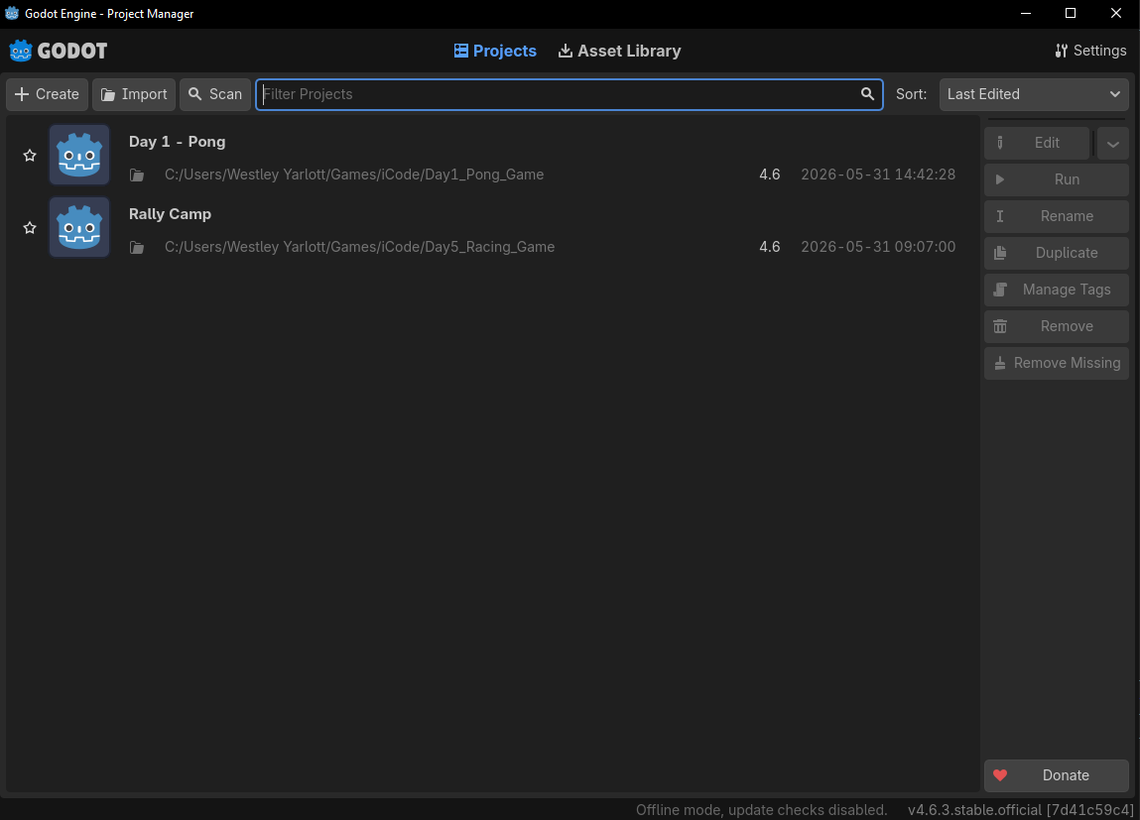
iCode
DAY 1
EMPOWERING FUTURE INNOVATORS
Launch Godot 4. The Project Manager window opens. Find the Import button at the top-right.
11

Slide 11
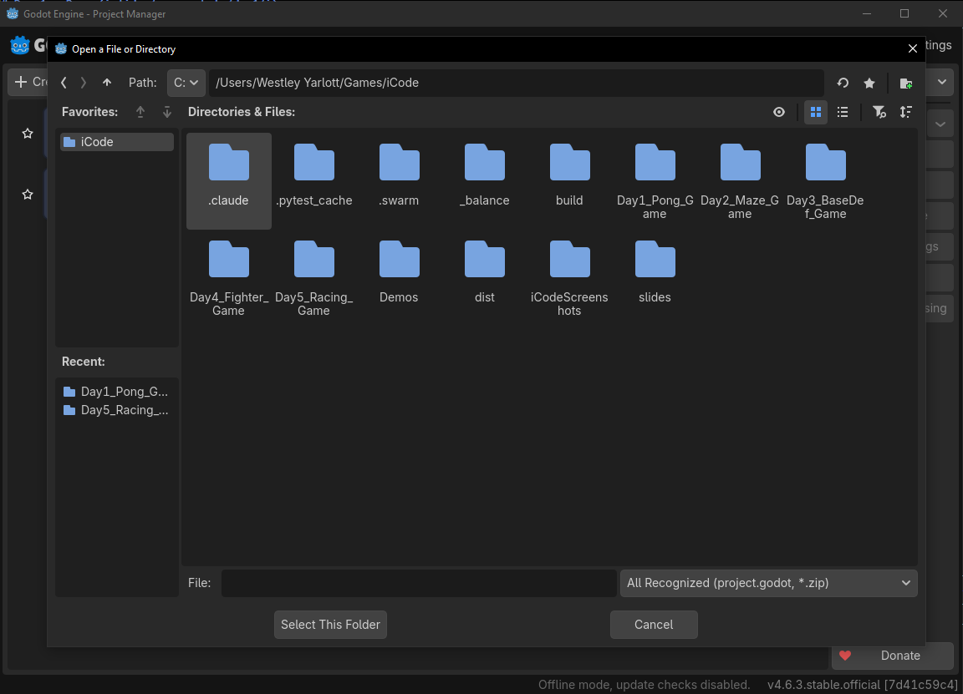
iCode
DAY 1
EMPOWERING FUTURE INNOVATORS
Click the Import button at the top-right of the Project Manager.
12

Slide 12
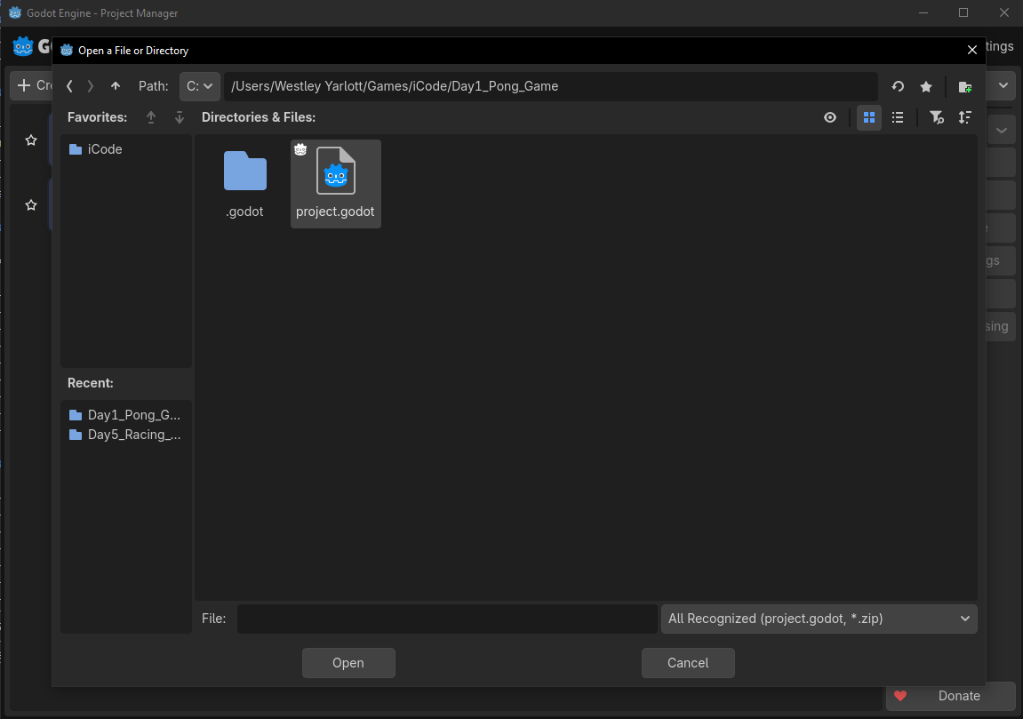
iCode
DAY 1
EMPOWERING FUTURE INNOVATORS
In the file browser, open the Day1_Pong_Game folder and click project.godot to select it.
13

Slide 13
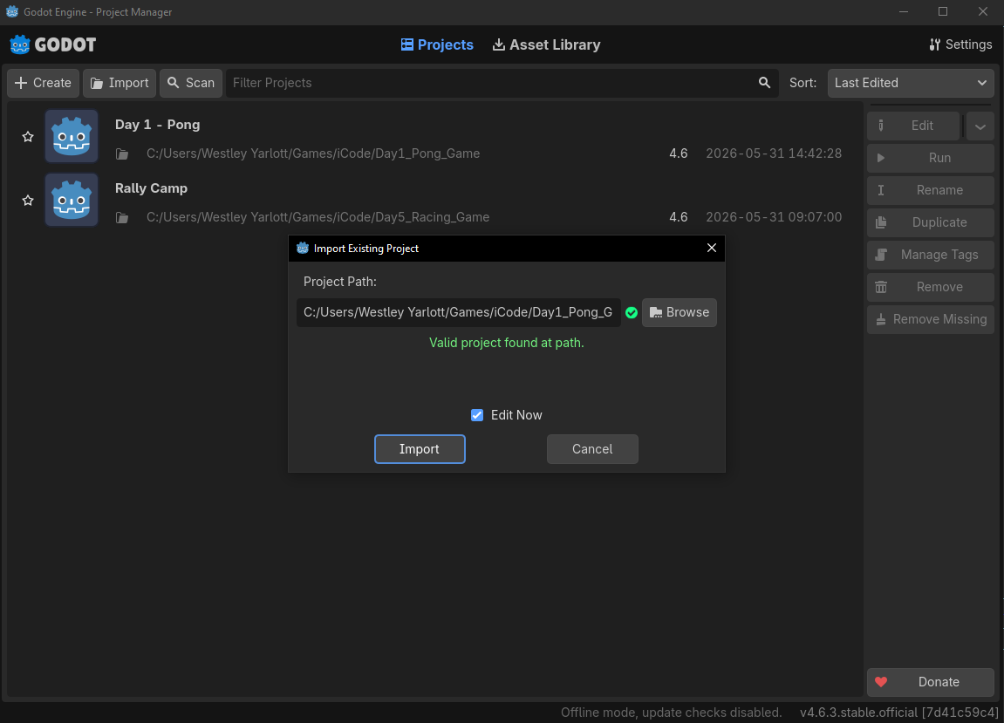
iCode
DAY 1
EMPOWERING FUTURE INNOVATORS
Godot asks to confirm. Click Import & Edit.
14

Slide 14
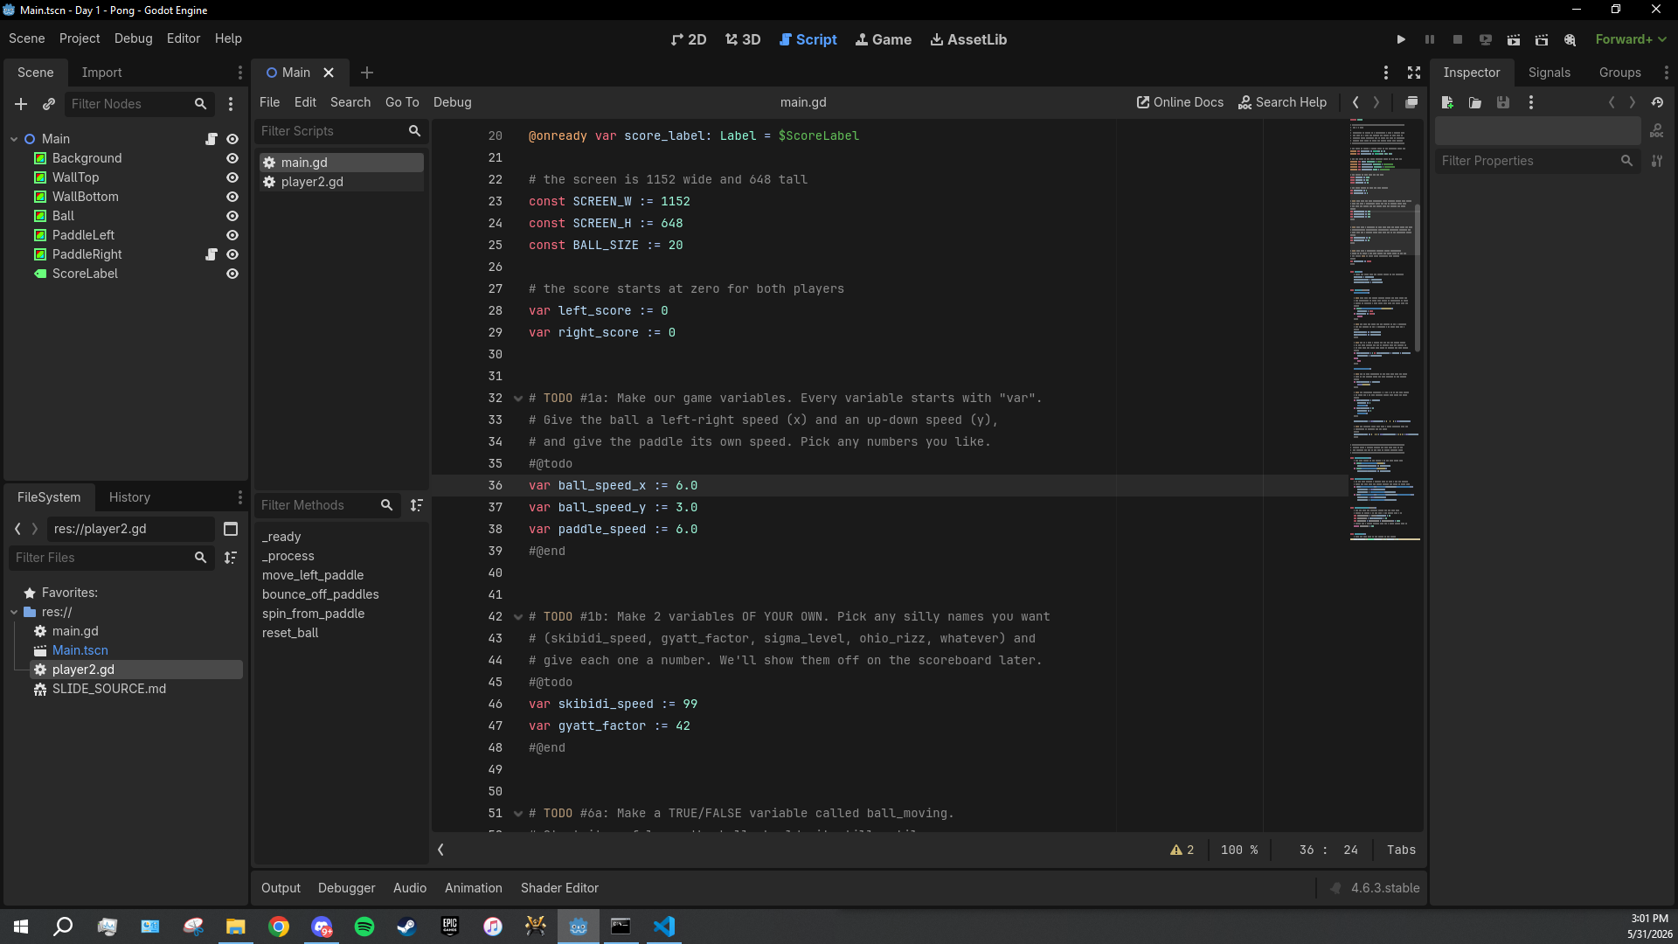
iCode
DAY 1
EMPOWERING FUTURE INNOVATORS
Godot imports the project (first time takes a few seconds) and the editor opens. You're in.
15

Slide 15
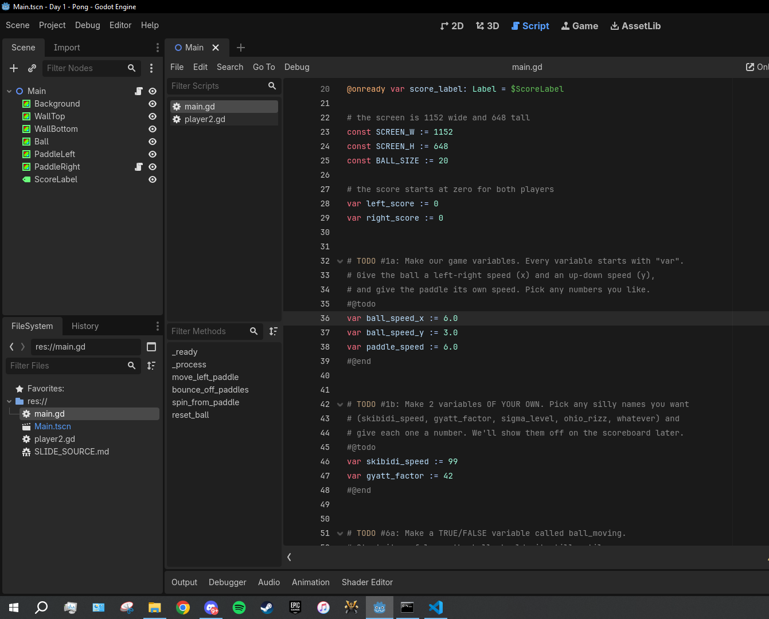
iCode
DAY 1
EMPOWERING FUTURE INNOVATORS
Look at the FileSystem panel (bottom-left). Find the file named main.gd.
16

Slide 16
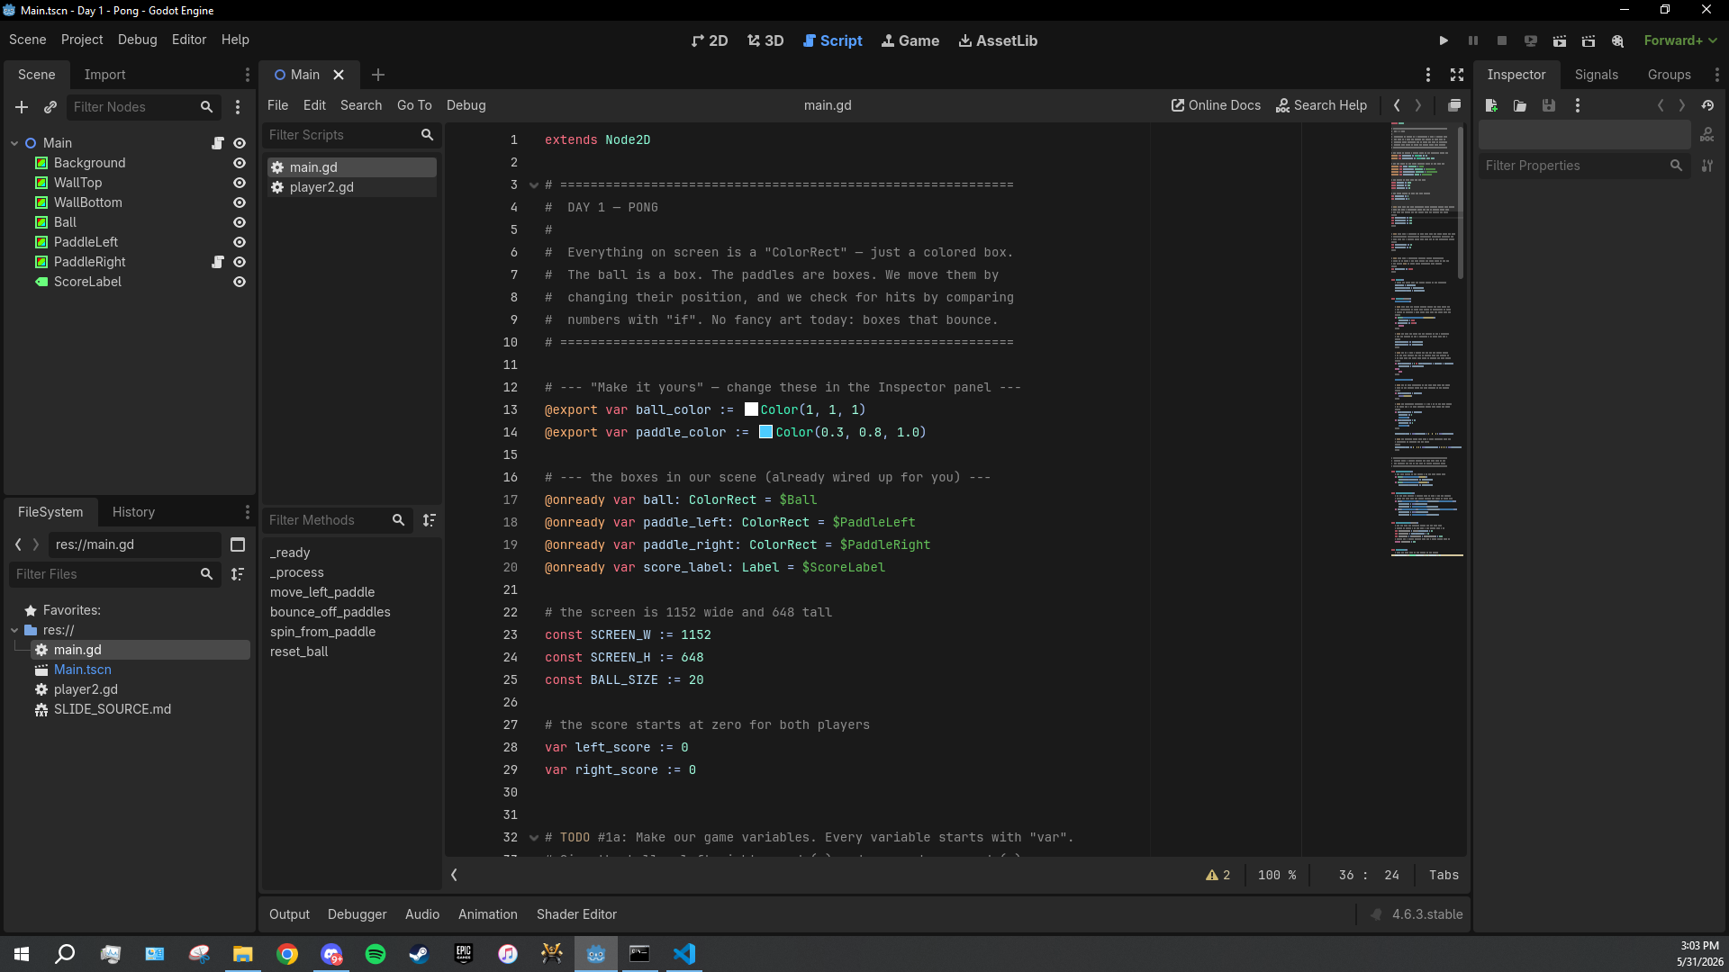
iCode
DAY 1
EMPOWERING FUTURE INNOVATORS
Hover main.gd, then double-click to open it.
The Script editor opens on main.gd. This is the file you'll edit all day.
17

Slide 17
iCode
DAY 1
EMPOWERING FUTURE INNOVATORS
[ MISSING: WalkB3.png ]
18

Slide 18
iCode
DAY 1
EMPOWERING FUTURE INNOVATORS
Lesson chunks
"Eight holes to fill. We'll fill them in order."
19

Slide 19
iCode
DAY 1
EMPOWERING FUTURE INNOVATORS
Variable
(just the word, very large, centred on slide)
20

Slide 20
iCode
DAY 1
EMPOWERING FUTURE INNOVATORS
What does variable mean?
"What does vary mean?"
21

Slide 21
iCode
DAY 1
EMPOWERING FUTURE INNOVATORS
vary = something that can change
22

Slide 22
iCode
DAY 1
EMPOWERING FUTURE INNOVATORS
V in variable → VALUE that can CHANGE
23

Slide 23
iCode
DAY 1
EMPOWERING FUTURE INNOVATORS
[ MISSING: d1_chunk1a_jar_empty.png ]
CookiesInJar = 0
24

Slide 24
iCode
DAY 1
EMPOWERING FUTURE INNOVATORS
[ MISSING: d1_chunk1a_jar_full.png ]
CookiesInJar = 8
25

Slide 25
iCode
DAY 1
EMPOWERING FUTURE INNOVATORS
You eat 3 cookies.
"What is CookiesInJar now?"
26

Slide 26
iCode
DAY 1
EMPOWERING FUTURE INNOVATORS
A variable is a VALUE that can CHANGE across time.
27

Slide 27
iCode
DAY 1
EMPOWERING FUTURE INNOVATORS
How does a video game use variables?
28

Slide 28
iCode
DAY 1
EMPOWERING FUTURE INNOVATORS
Pong's variables
• How fast is the ball moving left/right? → ball_speed_x
• How fast is the ball moving up/down? → ball_speed_y
• How fast does the paddle move? → paddle_speed
• Every frame, these numbers decide how fast everything goes.
29

Slide 29
iCode
DAY 1
EMPOWERING FUTURE INNOVATORS
[ MISSING: d1_chunk1a_reference.png ]
Up at the top of main.gd we already have two variables for the score.
30

Slide 30
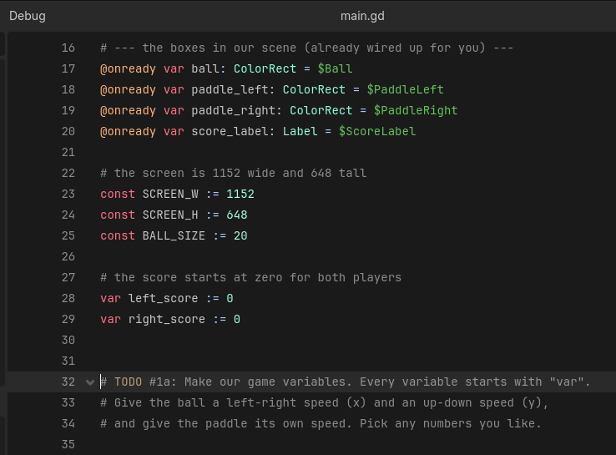
iCode
DAY 1
EMPOWERING FUTURE INNOVATORS
Right below the score, between #@todo and #@end, you'll add three variables of your own.
31

Slide 31
iCode
DAY 1
EMPOWERING FUTURE INNOVATORS
Make THREE variables: ball x-speed, ball y-speed, paddle speed. Pick any numbers.
Pattern (board example):
Where in your code (Godot):
var score := 0
32

Slide 32
iCode
DAY 1
EMPOWERING FUTURE INNOVATORS
Press the F5 key on your keyboard. (Or click the Play ▶ button in the top-right toolbar.)
33

Slide 33
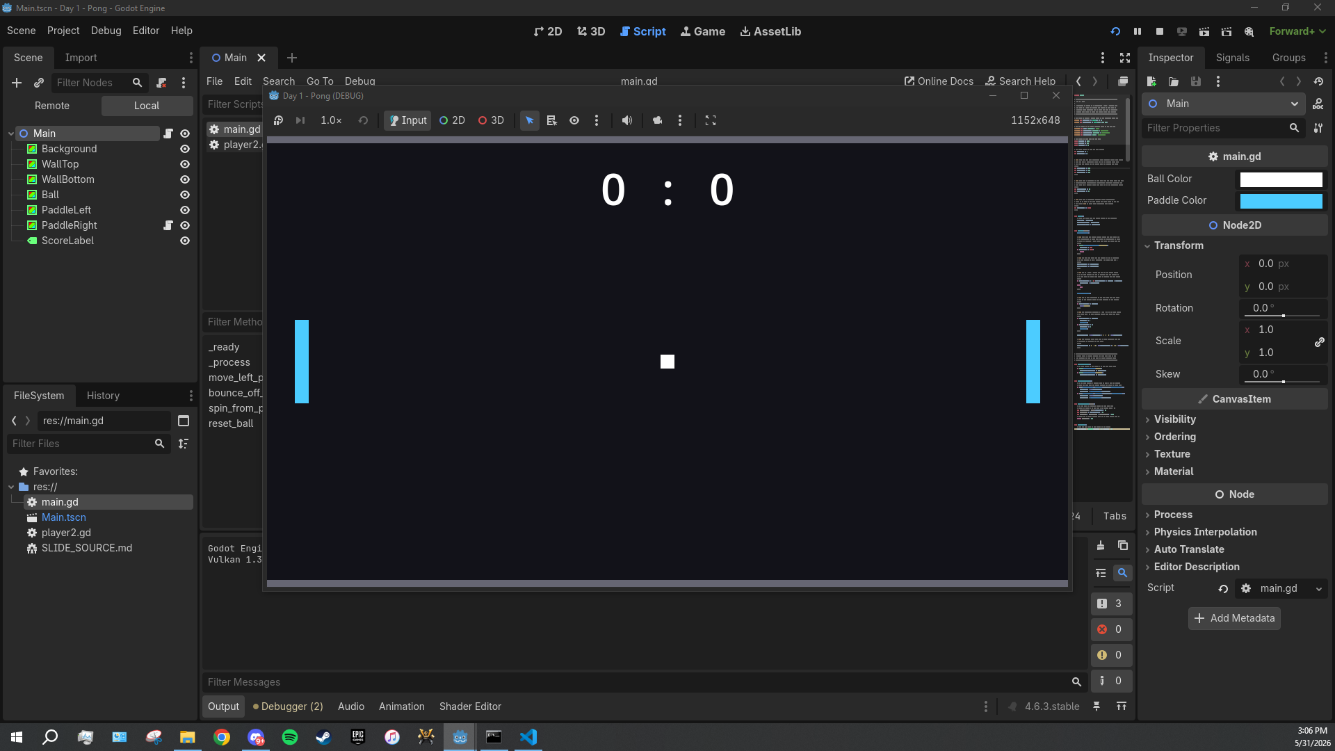
iCode
DAY 1
EMPOWERING FUTURE INNOVATORS
A new window pops up, 1152 × 648 pixels. Dark background, two cyan paddles. The ball will be frozen at the centre until chunk #6b — that's normal.
34

Slide 34
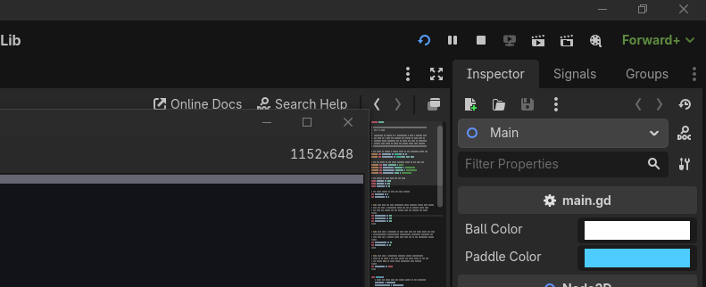
iCode
DAY 1
EMPOWERING FUTURE INNOVATORS
Close the game window, OR press F8 in the editor to stop it.
35

Slide 35
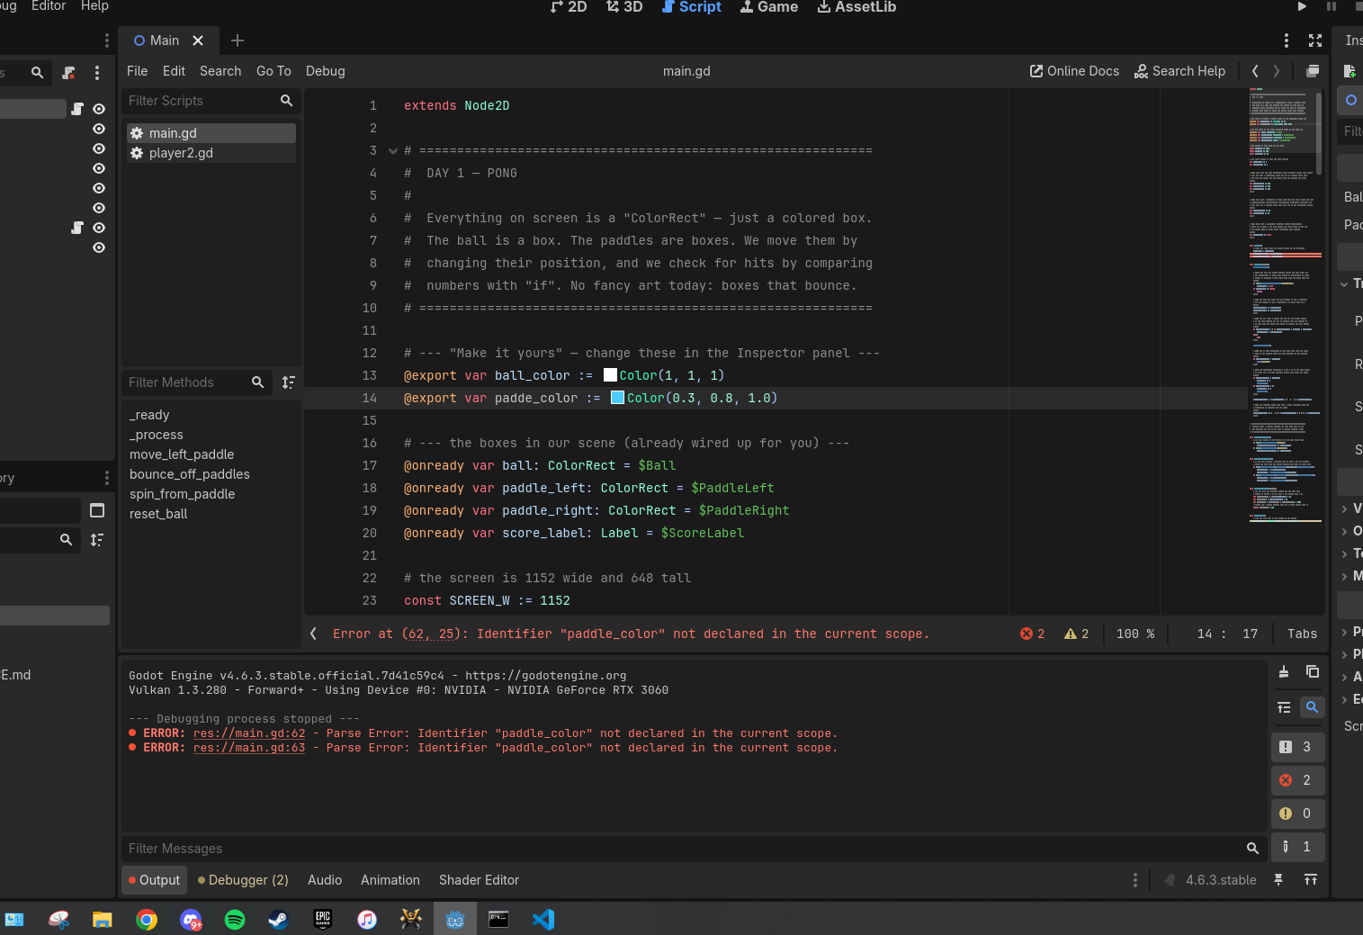
iCode
DAY 1
EMPOWERING FUTURE INNOVATORS
If your game window doesn't open after F5, look at the Output panel at the bottom of the editor. That's where errors print.
36

Slide 36
iCode
DAY 1
EMPOWERING FUTURE INNOVATORS
Step D.2 — Three errors you WILL hit
• Parse Error: Expected ':' after \"if\" condition. → you forgot the colon at the end of an if line.
• Identifier \"ball_speedy\" not declared in the current scope. → typo in a variable name (probably missing the _x or _y).
• Expected indented block. → the line after if ...: is not indented (use Tab or 4 spaces).
37

Slide 37
iCode
DAY 1
EMPOWERING FUTURE INNOVATORS
Naming your variables
38

Slide 38
iCode
DAY 1
EMPOWERING FUTURE INNOVATORS
Code doesn't care what you call a variable.
"The name is for YOU."
39

Slide 39
iCode
DAY 1
EMPOWERING FUTURE INNOVATORS
Programmers go SILLY on purpose
• foobar and bazinga are decades-old programmer jokes — built right into real codebases.
• Even Claude (the AI in your editor) types nonsense words like fligerbigitibetting when it's just thinking out loud.
• Making code feel personal makes it more fun to read AND more fun to write.
40

Slide 40
iCode
DAY 1
EMPOWERING FUTURE INNOVATORS
Both work — pick your favourite
var score := 0
41

Slide 41
iCode
DAY 1
EMPOWERING FUTURE INNOVATORS
What's the funniest variable name you can think of?
42

Slide 42
iCode
DAY 1
EMPOWERING FUTURE INNOVATORS
Your code, your names.
43

Slide 43
iCode
DAY 1
EMPOWERING FUTURE INNOVATORS
Real game studios do this every day
"Codebases are full of inside jokes, pet names, and references hidden in variable names. It's part of the culture."
44

Slide 44
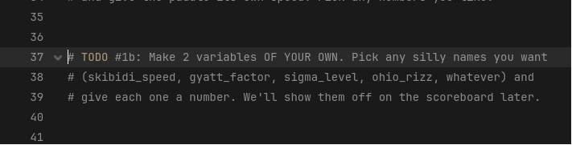
iCode
DAY 1
EMPOWERING FUTURE INNOVATORS
Right below your chunk #1a variables, you've got another #@todo block waiting for two more — names of your choosing.
45

Slide 45
iCode
DAY 1
EMPOWERING FUTURE INNOVATORS
Make TWO variables — any name, any starting number. Go weird if you want.
Pattern (board example):
Where in your code (Godot):
var skibidi_speed := 99
46

Slide 46
iCode
DAY 1
EMPOWERING FUTURE INNOVATORS
Boolean
47

Slide 47
iCode
DAY 1
EMPOWERING FUTURE INNOVATORS
A variable with only TWO possible values.
48

Slide 48
iCode
DAY 1
EMPOWERING FUTURE INNOVATORS
Those two values: true or false.
"No numbers. No text. Just yes or no."
49

Slide 49
iCode
DAY 1
EMPOWERING FUTURE INNOVATORS
Boolean = a YES/NO switch.
50

Slide 50
iCode
DAY 1
EMPOWERING FUTURE INNOVATORS
Is the light in this room on right now?
"True or false?"
53

Slide 51
iCode
DAY 1
EMPOWERING FUTURE INNOVATORS
A boolean is a true/false switch. Like a light switch.
54

Slide 52
iCode
DAY 1
EMPOWERING FUTURE INNOVATORS
Games are full of yes/no switches
• Is the player alive? is_alive
• Is the game paused? is_paused
• Is the door locked? door_locked
• All booleans.
55

Slide 53
iCode
DAY 1
EMPOWERING FUTURE INNOVATORS
Today in Pong: is the ball moving yet?
"That's a boolean. We'll call it ball_moving."
56

Slide 54
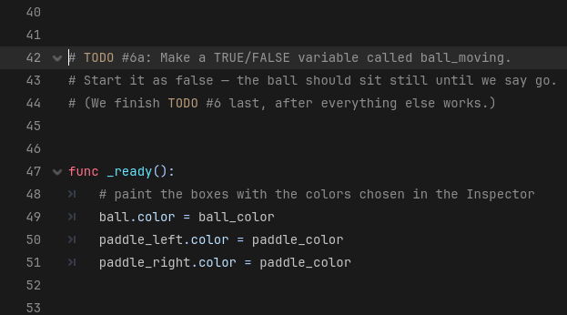
iCode
DAY 1
EMPOWERING FUTURE INNOVATORS
Just below your variables from #1b, there's a #@todo block for one boolean.
57

Slide 55
iCode
DAY 1
EMPOWERING FUTURE INNOVATORS
Make a true/false variable called ball_moving. Start it as false.
Pattern (board example):
Where in your code (Godot):
var is_alive := true
58

Slide 56
iCode
DAY 1
EMPOWERING FUTURE INNOVATORS
if statement
59

Slide 57
iCode
DAY 1
EMPOWERING FUTURE INNOVATORS
An if runs a block of code ONLY WHEN something is true.
60

Slide 58
iCode
DAY 1
EMPOWERING FUTURE INNOVATORS
The shape
if [something is true]:
do this
and this
61

Slide 59
iCode
DAY 1
EMPOWERING FUTURE INNOVATORS
IF you finish your veggies → you get dessert.
"What if you DIDN'T finish?"
63

Slide 60
iCode
DAY 1
EMPOWERING FUTURE INNOVATORS
if is a rule that only fires when its condition is true.
"Otherwise: nothing."
64

Slide 61
iCode
DAY 1
EMPOWERING FUTURE INNOVATORS
Every game runs on if checks. Every. Single. Frame.
• if button pressed → jump
• if enemy near → attack
• if health = 0 → game over
65

Slide 62
iCode
DAY 1
EMPOWERING FUTURE INNOVATORS
Today in Pong:
"IF the player has NOT pressed Space yet → freeze the ball. Use return to skip the rest of the frame."
66

Slide 63
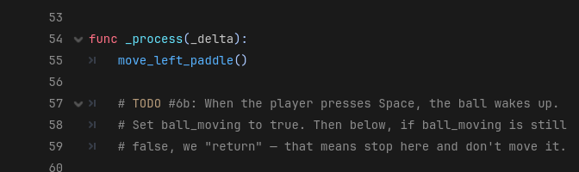
iCode
DAY 1
EMPOWERING FUTURE INNOVATORS
Inside the _process function, near the top.
67

Slide 64
iCode
DAY 1
EMPOWERING FUTURE INNOVATORS
When the player presses Space → flip ball_moving to true. While ball_moving is still false → return to freeze the ball.
Pattern (board example):
Where in your code (Godot):
if is_alive == false:
return
68

Slide 65
iCode
DAY 1
EMPOWERING FUTURE INNOVATORS
Press F5. The ball sits frozen at the center until you tap Space. Then it moves.
69

Slide 66
iCode
DAY 1
EMPOWERING FUTURE INNOVATORS
Updating a variable
We already know var makes a variable. Now we UPDATE one. x = x + 1 works — but x += 1 is the shortcut every programmer uses for the rest of their life.
70

Slide 67

iCode
DAY 1
EMPOWERING FUTURE INNOVATORS
Add ball_speed_x to ball.position.x every frame. Same for y. The ball will start moving (and drift off-screen — we'll catch it next).
Pattern (board example):
Where in your code (Godot):
score = score + 1
# …same thing, shorter:
score += 1
71

Slide 68
iCode
DAY 1
EMPOWERING FUTURE INNOVATORS
Press F5, then Space. The ball drifts off the right side of the screen. That's expected — chunk #4 catches it.
72

Slide 69
iCode
DAY 1
EMPOWERING FUTURE INNOVATORS
if / else
73

Slide 70
iCode
DAY 1
EMPOWERING FUTURE INNOVATORS
else is the OTHERWISE branch.
"When the if is NOT true → run the else block instead."
74

Slide 71
iCode
DAY 1
EMPOWERING FUTURE INNOVATORS
if / else = two paths. ONE always runs.
75

Slide 72
iCode
DAY 1
EMPOWERING FUTURE INNOVATORS
IF it's raining → umbrella.
"ELSE → ?"
77

Slide 73
iCode
DAY 1
EMPOWERING FUTURE INNOVATORS
One of the two paths ALWAYS runs.
78

Slide 74
iCode
DAY 1
EMPOWERING FUTURE INNOVATORS
Two-outcome checks are everywhere
• if you have the key → open the door, else → it stays locked
• if HP > 0 → take damage, else → game over
• if input pressed → move, else → idle
79

Slide 75
iCode
DAY 1
EMPOWERING FUTURE INNOVATORS
Today in Pong:
"IF the ball hit the top OR bottom wall → flip its vertical speed. ELSE → let it keep going."
80

Slide 76
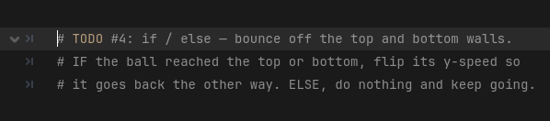
iCode
DAY 1
EMPOWERING FUTURE INNOVATORS
Inside _process, right after we move the ball.
81

Slide 77
iCode
DAY 1
EMPOWERING FUTURE INNOVATORS
When the ball goes off the top OR bottom → flip ball_speed_y. Else → keep going (use pass for now).
Pattern (board example):
Where in your code (Godot):
if hungry:
eat()
else:
sleep()
82

Slide 78
iCode
DAY 1
EMPOWERING FUTURE INNOVATORS
Press F5, then Space. The ball ricochets off the top and bottom walls now. It still flies off the LEFT and RIGHT sides — chunk #5 fixes that.
83

Slide 79
iCode
DAY 1
EMPOWERING FUTURE INNOVATORS
if — without an else
Same if from chunk #6b. This time we use it WITHOUT an else. If the check fails → nothing happens (no else, no other path).
84

Slide 80
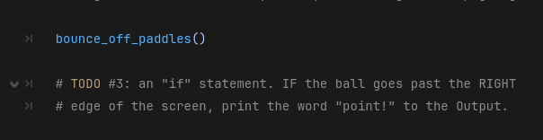
iCode
DAY 1
EMPOWERING FUTURE INNOVATORS
When the ball goes past the right edge → print(\"point!\") to the Output panel. (Real scoring comes in #5.)
Pattern (board example):
Where in your code (Godot):
if score > 5:
print("winning")
85

Slide 81
iCode
DAY 1
EMPOWERING FUTURE INNOVATORS
Press F5. Let the ball go past the right edge. Look at the Output panel — point! prints.
86

Slide 82
iCode
DAY 1
EMPOWERING FUTURE INNOVATORS
Comparison operators
87

Slide 83
iCode
DAY 1
EMPOWERING FUTURE INNOVATORS
Use them inside if
if score > 5:
print("winning")
89

Slide 84
iCode
DAY 1
EMPOWERING FUTURE INNOVATORS
You're 50 inches tall.
"Can you ride? What's the check? your_height > 48 — true or false?"
91

Slide 85
iCode
DAY 1
EMPOWERING FUTURE INNOVATORS
> and < let if compare two numbers.
93

Slide 86
iCode
DAY 1
EMPOWERING FUTURE INNOVATORS
Games are constantly comparing numbers
• is score > high score?
• is health < 20%?
• is enemy distance < 100 pixels?
• is timer == 0?
94

Slide 87
iCode
DAY 1
EMPOWERING FUTURE INNOVATORS
Today in Pong:
"Is the ball past the right edge? (ball.x > SCREEN_W) → left player scores. Past the left edge? (ball.x < 0) → right player scores."
95

Slide 88
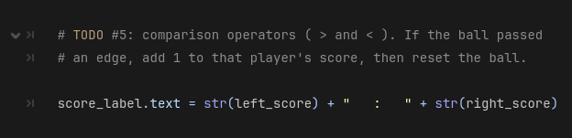
iCode
DAY 1
EMPOWERING FUTURE INNOVATORS
Same area you put the print(\"point!\") test. We're upgrading it to real scoring.
96

Slide 89
iCode
DAY 1
EMPOWERING FUTURE INNOVATORS
Use > for the right edge and < for the left edge. Bump the correct score and call reset_ball().
Pattern (board example):
Where in your code (Godot):
if lives == 0:
game_over()
97

Slide 90
iCode
DAY 1
EMPOWERING FUTURE INNOVATORS
Press F5, then Space. Score a point past either edge. The number at the top of the screen jumps up.
98

Slide 91
iCode
DAY 1
EMPOWERING FUTURE INNOVATORS
Remember your silly variables?
Time to put your #1b variables ON SCREEN. We use str() to turn numbers into text so we can stick them onto the scoreboard.
99

Slide 92
iCode
DAY 1
EMPOWERING FUTURE INNOVATORS
Append your two silly variables onto score_label.text. Decorate with stars, emojis, whatever you want.
Pattern (board example):
Where in your code (Godot):
label.text = "Speed: " + str(skibidi_speed)
[ MISSING: D1C1c.png ]
100

Slide 93
iCode
DAY 1
EMPOWERING FUTURE INNOVATORS
Run it. The scoreboard now shows your skibidi_speed (or whatever you called it) right next to the score.
101

Slide 94
iCode
DAY 1
EMPOWERING FUTURE INNOVATORS
Make it yours
Five ways to make this Pong YOUR Pong. Pick the ones you want — do them in any order.
102

Slide 95
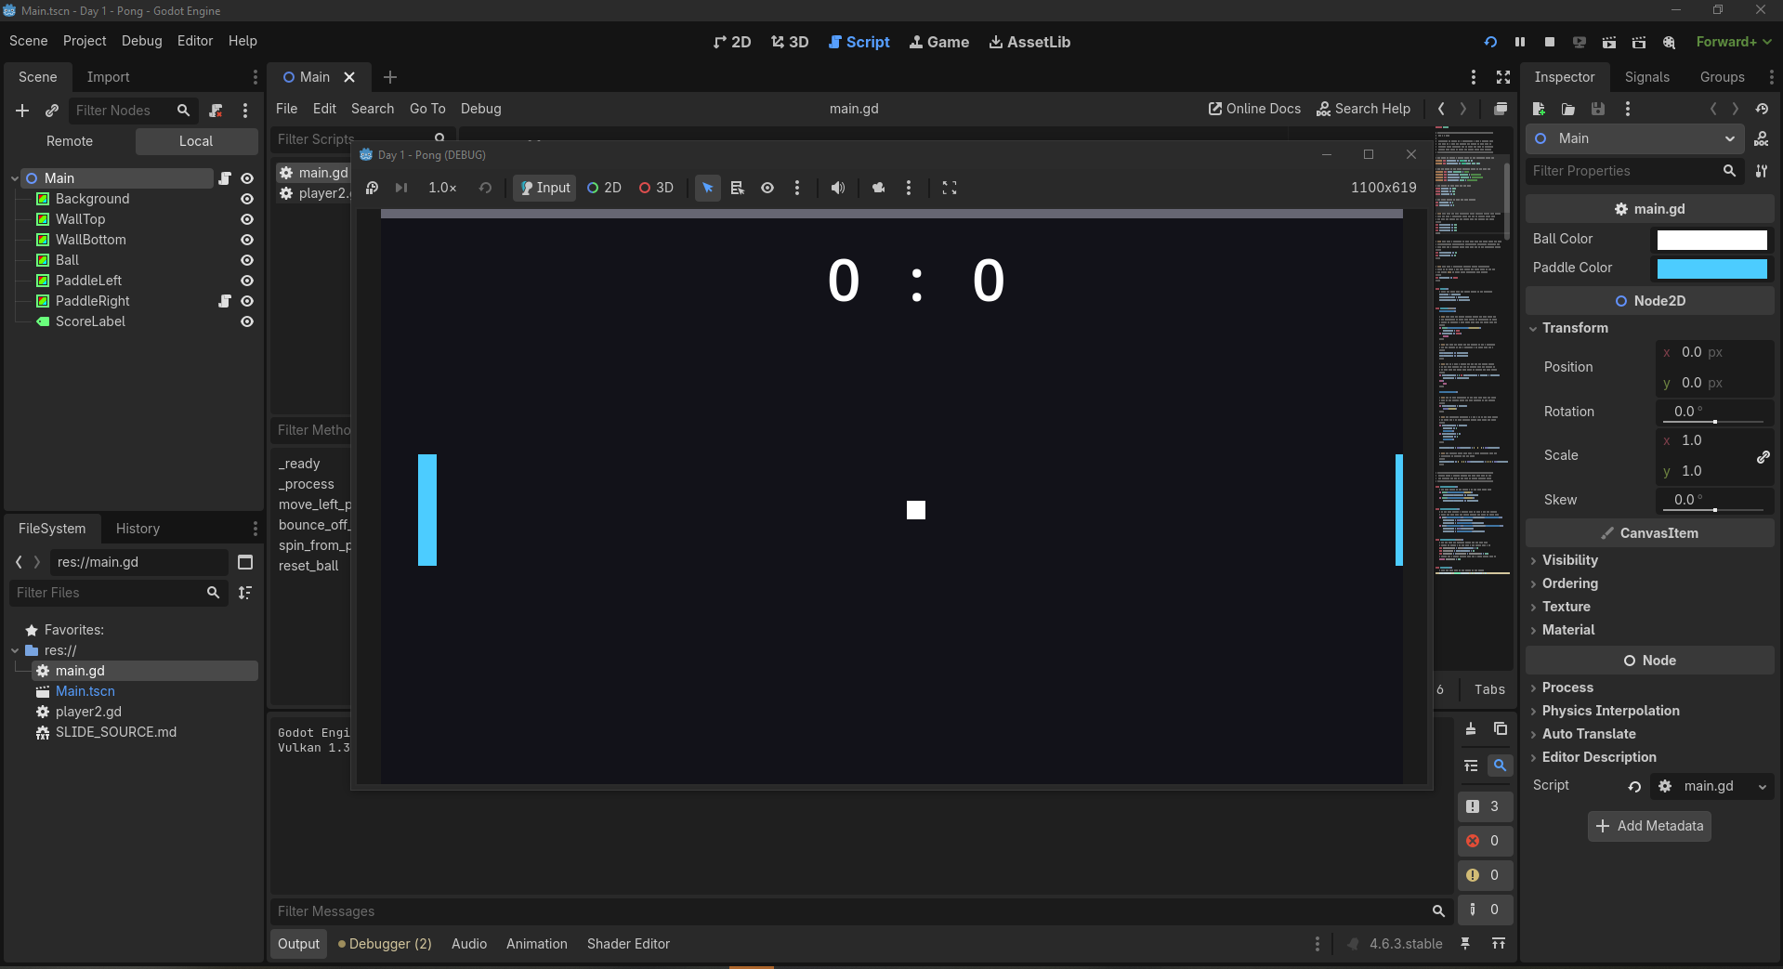
iCode
DAY 1
EMPOWERING FUTURE INNOVATORS
[ MISSING: d1_beat1_step1.png ]
Click the Main node at the top of the Scene panel (top-left).
103

Slide 96
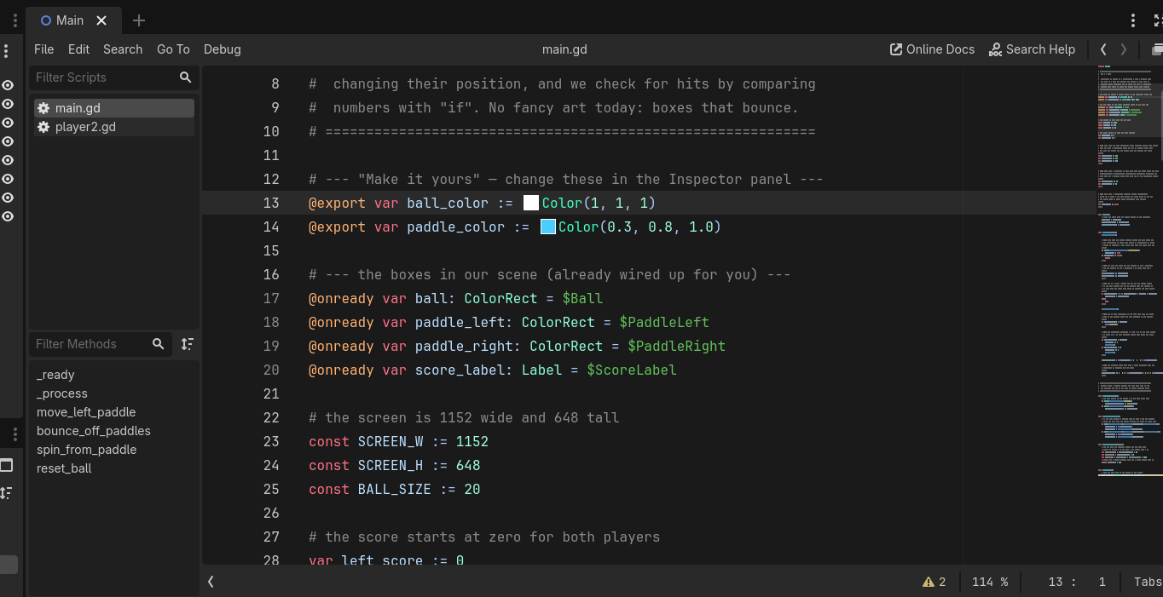
Look at the Inspector on the right. Scroll down to the Script Variables section — that's where Ball Color and Paddle Color live.
iCode
DAY 1
EMPOWERING FUTURE INNOVATORS
[ MISSING: d1_beat1_step2.png ]
Click the colour swatch next to Ball Color. The colour picker pops up. Pick anything you like.
Click the colour swatch next to Ball Color. The colour picker pops up. Pick anything you like.
104

Slide 97
iCode
DAY 1
EMPOWERING FUTURE INNOVATORS
Press Ctrl+S to save the scene, then F5 to run. Your new colours are live.
107

Slide 98
iCode
DAY 1
EMPOWERING FUTURE INNOVATORS
Open main.gd. Find your chunk #1a line: var ball_speed_x := 6.0.
108

Slide 99
iCode
DAY 1
EMPOWERING FUTURE INNOVATORS
Click the 6.0 and change it — higher for a faster ball, lower for slower. Try the 3–12 range. Save (Ctrl+S), run (F5).
109

Slide 100
iCode
DAY 1
EMPOWERING FUTURE INNOVATORS
Why colours were in the Inspector but speeds weren't
• The colour variables have a special word in front: @export.
• @export means: show this variable in the Inspector so I can change it without opening the code.
• The speeds don't have it — so you change them in the code instead. Same idea, two doors in.
110

Slide 101
iCode
DAY 1
EMPOWERING FUTURE INNOVATORS
Final Challenge — player2.gd
Kick out the computer. Make Pong 2-player — your friend plays the right paddle on the I and K keys.
117

Slide 102
iCode
DAY 1
EMPOWERING FUTURE INNOVATORS
You already know how to do this
• Step 1 — turn the AI off" → "reading code + # to comment out lines
• Step 2 — I/K keys move the paddle" → "chunk #1a (paddle_speed) + chunk #3 (if)
118

Slide 103
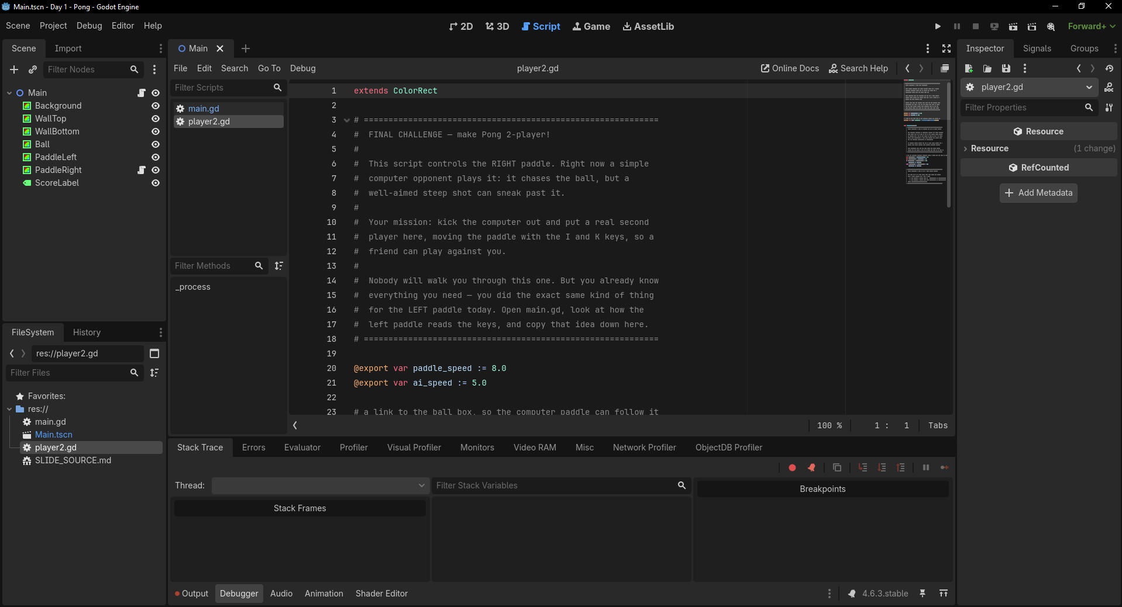
iCode
DAY 1
EMPOWERING FUTURE INNOVATORS
Right now the right paddle is a computer. After this challenge, a real second player controls it — I = up, K = down. Pong becomes 2-player.
119

Slide 104
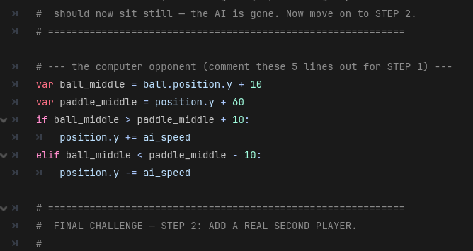
iCode
DAY 1
EMPOWERING FUTURE INNOVATORS
[ MISSING: d1_fc_step1_where.png ]
Open player2.gd (it's on the PaddleRight node). The 5 lines in _process that start with var ball_middle = … down through position.y -= ai_speed —
that's the AI playing itself.
120

Slide 105
iCode
DAY 1
EMPOWERING FUTURE INNOVATORS
Select those 5 lines and comment them out — put a # at the start of each, or select them and press Ctrl+K. Run (F5): the right paddle should now sit still.
121

Slide 106
iCode
DAY 1
EMPOWERING FUTURE INNOVATORS
Just below the AI block, under the STEP 2 banner, there's a #@todo block. That's where you make the I and K keys move the paddle.
122

Slide 107
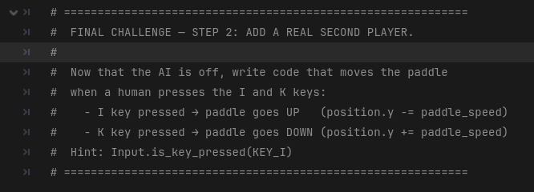
iCode
DAY 1
EMPOWERING FUTURE INNOVATORS
I moves up (subtract), K moves down (add). Use your paddle_speed. Same if shape as this morning.
Pattern (board example):
Where in your code (Godot):
if Input.is_key_pressed(KEY_?):
position.y -= ???
if Input.is_key_pressed(KEY_?):
position.y += ???
[ MISSING: d1_fc_step2_todo.png ]
123

Slide 108
iCode
DAY 1
EMPOWERING FUTURE INNOVATORS
Day 1 assets: none
Day 1 used zero imported art. Every visible thing on screen was a ColorRect — a coloured box drawn by code. From Day 2 on, we bring in real art with Kenney.nl asset packs.
124

Slide 109
iCode
DAY 1
EMPOWERING FUTURE INNOVATORS
Take it home
Turn your Pong into a real Windows program — a .exe you can run on any PC, no Godot needed. Show your family tonight.
125

Slide 110
iCode
DAY 1
EMPOWERING FUTURE INNOVATORS
Save the scene with Ctrl+S, then click into the script editor and Ctrl+S again. No asterisks left next to the tab names = everything's saved.
126

Slide 111
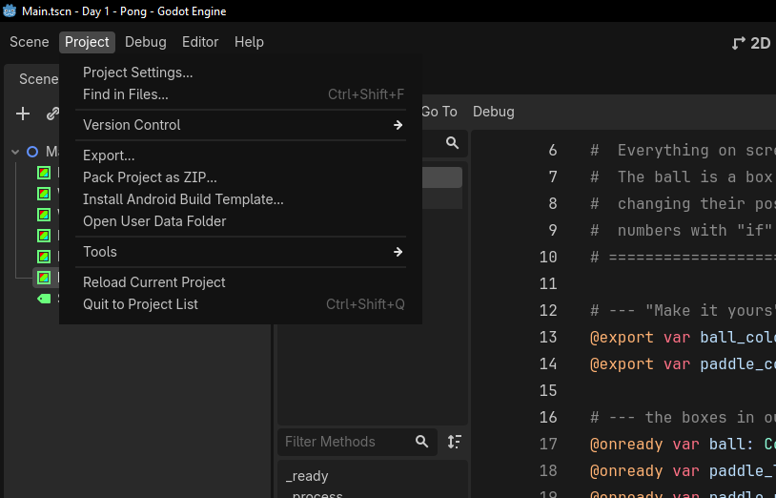
iCode
DAY 1
EMPOWERING FUTURE INNOVATORS
[ MISSING: d1_export_step2.png ]
In the top menu bar: Project → Export…
127

Slide 112
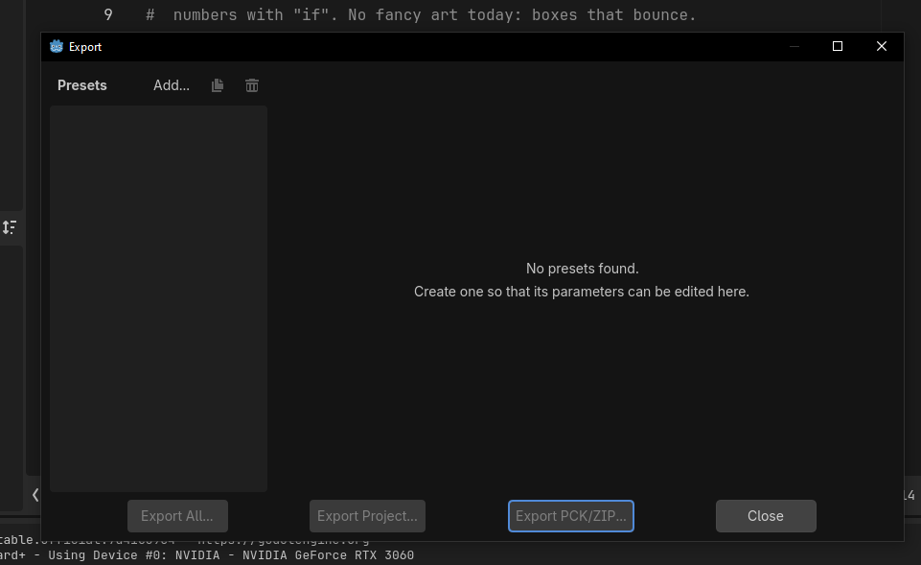
iCode
DAY 1
EMPOWERING FUTURE INNOVATORS
[ MISSING: d1_export_step3.png ]
In the Export window, select the Windows Desktop preset. (Your instructor set this up already.)
128

Slide 113
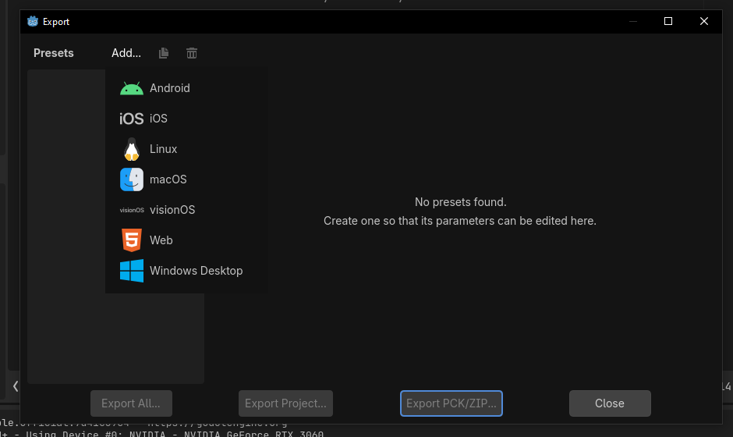
iCode
DAY 1
EMPOWERING FUTURE INNOVATORS
[ MISSING: d1_export_step4.png ]
Click Windows Desktop at the bottom of the dropdown.
129

Slide 114
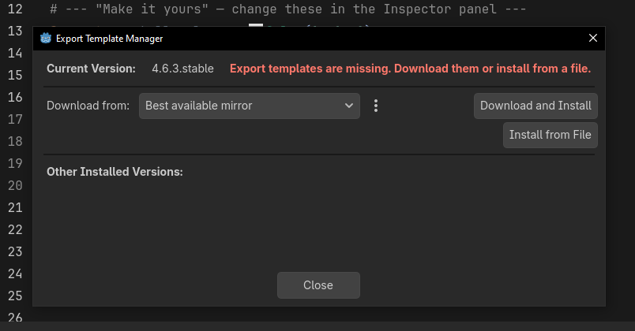
iCode
DAY 1
EMPOWERING FUTURE INNOVATORS
[ MISSING: d1_export_step5.png ]
Click “Go online” if needed
Then click “Download and Install”
If you don’t see an error, than you’re chillin’
(though idk how you didn’t have to do this step unless someone else has done it before lol)
130

Slide 115
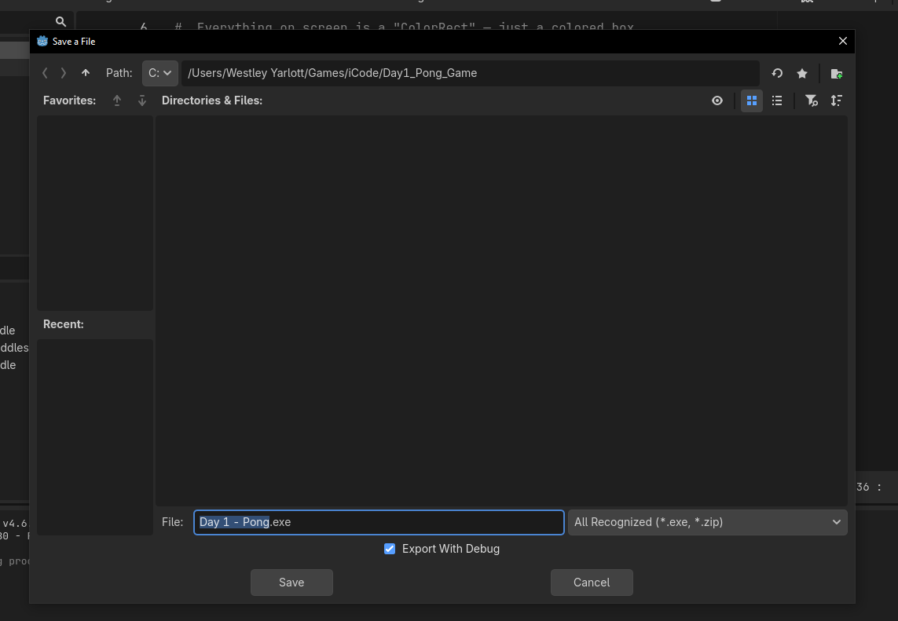
iCode
DAY 1
EMPOWERING FUTURE INNOVATORS
[ MISSING: d1_export_step6.png ]
Select the preset and click “Export Project”. You should now see this screen.
Uncheck Export With Debug — it keeps your .exe smaller.
131

Slide 116
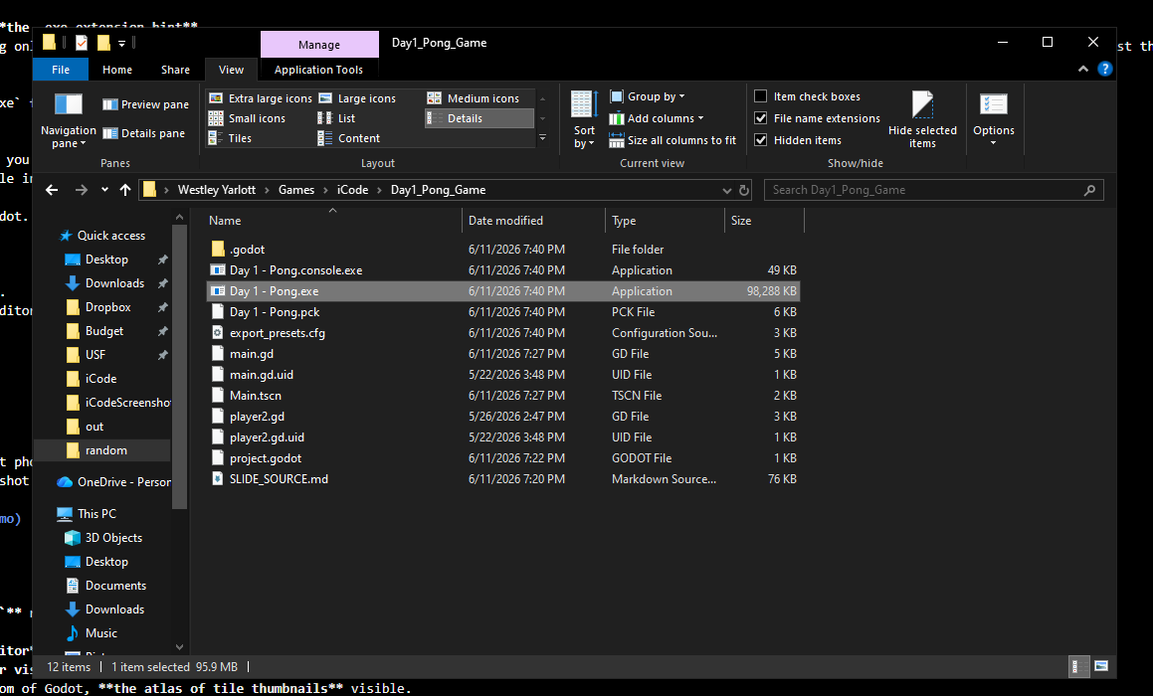
iCode
DAY 1
EMPOWERING FUTURE INNOVATORS
Click Save. Godot builds your game.
You should see it in your files as a .exe file, something like this that’s highlighted white.
You can double-click that .exe file on any windows computer (at home, at a friends house)
And run it, I encourage you to show it off to your friends/family.
This is how real games are made, not in editors but as real executable files.
[ MISSING: d1_export_step7.png ]
132

Slide 117
iCode
DAY 1
EMPOWERING FUTURE INNOVATORS
[ MISSING: d1_export_step8.png ]
Godot writes two files into your folder: <name>.exe (the game) and <name>.pck (its data). Keep them together.
133

Slide 118
iCode
DAY 1
EMPOWERING FUTURE INNOVATORS
It's really yours now
Copy that folder to a USB stick or send it to a friend. It runs on any Windows PC. You built and shipped a real game on day one.
135

Slide 119
iCode
DAY 1
EMPOWERING FUTURE INNOVATORS
Tomorrow: Pac-Man
1980. The next leap. We trade coloured rectangles for tiles — and learn loops and functions to bring a whole maze to life.
136

